Slide 1

Plan-AI
Smart Travel Companion for Tailored, Budget-Friendly Trips using LLM Plannings
-Tanisha Karmakar(21051950)
-Adarsh Tiwari(21052554)
-Shubhangi Sinha(21051939)
-Debadrita Mandal(21051808)
1

Slide 2
Introduction
Plan-AI is an innovative project that leverages artificial intelligence (AI) to simplify travel planning across India. By using advanced technologies like natural language processing (NLP) and large language models (LLMs), Plan-AI creates personalized itineraries based on user preferences, budgets, and travel durations. Traditional travel planning often struggles to handle these variables, but Plan-AI automates the process, making it more efficient and user-friendly. This AI-driven tool aims to enhance the travel experience and promote tourism, making travel planning more accessible and tailored to individual needs.
2

Slide 3
Aims & Objectives
Plan AI aims to streamline travel planning by leveraging artificial intelligence to create customized itineraries based on user input. It integrates real-time data on transportation, accommodation, and attractions while ensuring cost-efficiency and convenience. The objective is to provide users with dynamic, adaptive travel solutions that simplify decision-making and enhance the overall travel experience
3

Slide 4

Technology Used:
Groq API
Large Language Models
Natural Language Processing
React JS(Frontend)
Flask(Backend)
MYSQL(Database)
4

Slide 5

Problem
Statement:
Make a smart and efficient travel planning web application using LLM’s with a better user experience.
5

Slide 6
Solution:
BUDGET CONSTRAINTS
LOCAL RECOMMENDATIONS:
SMART PLANNING
Planning a trip as per your budget and experiences like place of stay,mode of travel, adventures etc.
Planning a trip keeping things recommended by the locals like food, local travel,and tickets for sightseeing.
Planning a trip with constraints like no. of days, mode of travel, sightseeing
6

Slide 7

Future Upgrades:
PHASE 2
PHASE 3
PHASE 1
Smart travel panning with features like redirecting to booking’s page and suggesting travel as per you.
Smart web app with features like automatic flight bookings, hotel bookings and tickets for sightseeing.
Smart Planner using LLM’s.
7

Slide 8



Impact on Society:
Users get an overall travel experience with a smart and complete knowledge about their destinations and have an itenary planned which makes travel easy, comfortable and stress free that to according to their personal interests and budget.
8

Slide 9

Project Links:
https://github.com/tanishakarmakar/Plan-AI
HTTPS://PLAN-AI-SNOWY.VERCEL.APP/
9

Slide 10
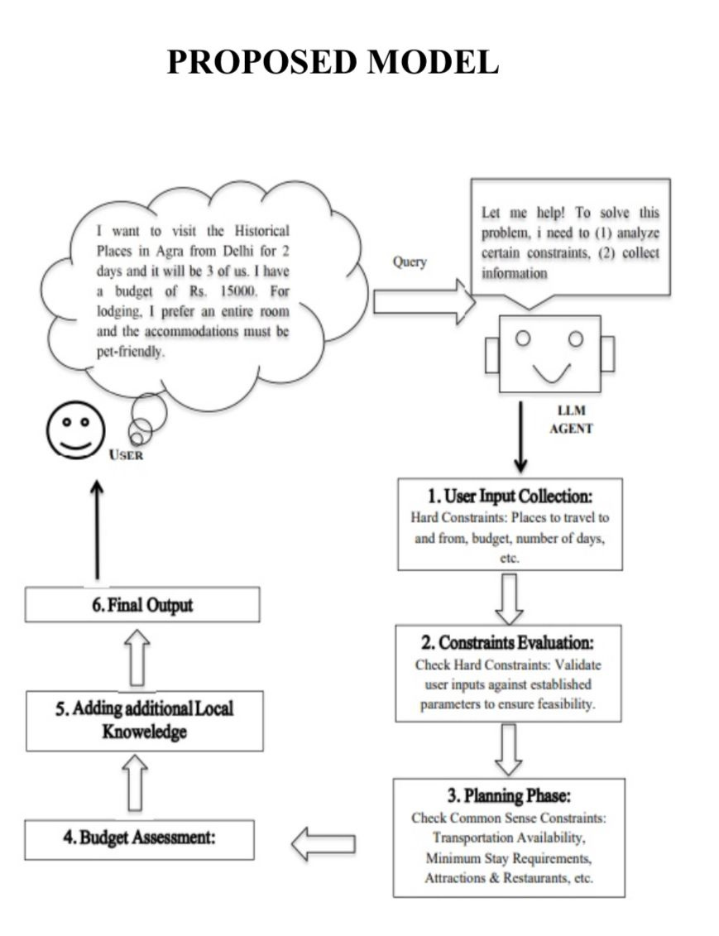
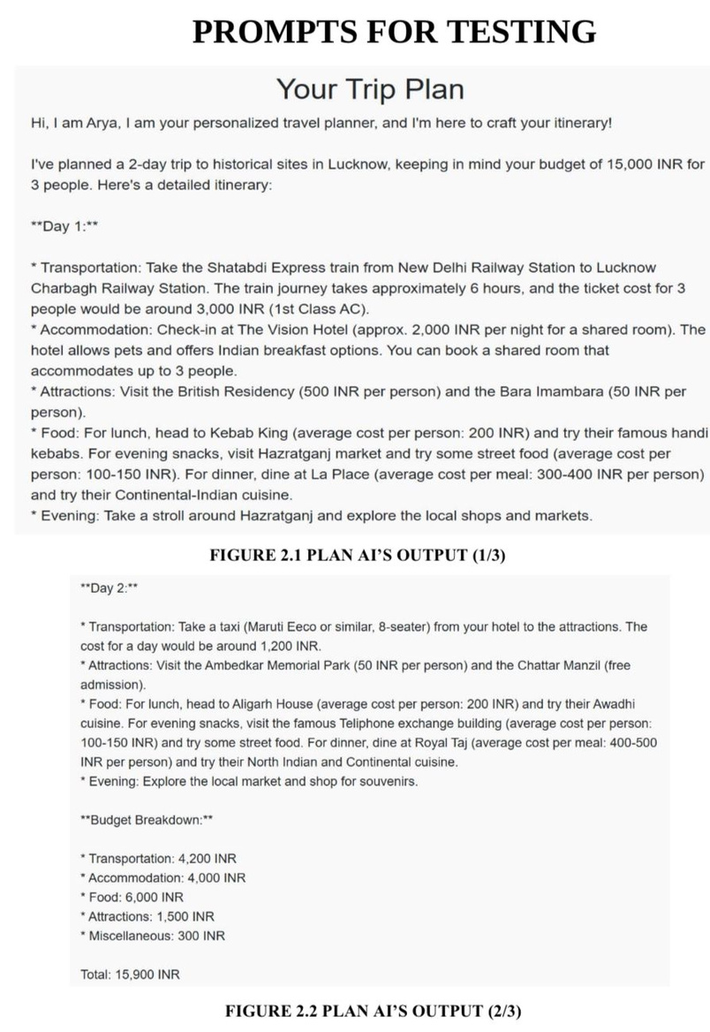
10

Slide 11

Output Generation
FINAL ITENARY ASSEMBLY:
Once all constraints and preferences are evaluated,the LLM finalizes the travel plan.
PRESENTATION TO USER:
The itenary is presented on the frontend in an easy-to-read-format.
USER FEEDBACK LOOP:
Users can rate and provide feedback on the travel plans,which helps refine the LLM’s.
11

Slide 12
Conclusion and Future Scope:
Key Achievements:
Automated Planning and Optimization
Data Driven Insights
User Friendly Interface
Enhanced Machine Learning Models
Expanding Domain-Specific Capabilities.
12

Slide 13
THANK YOU!!
13

